Slide 1


micro:bit robot entry tutorial
Lesson 10
micro:bit robot lesson 10 “APP control”
YahBoom micro:bit video tutorial

Slide 2
micro:bit robot entry tutorial
Content
Part1
Part 2
Part3
Learning goals
Preparation
Usage method
YahBoom micro:bit video tutorial

Slide 3
!!!Note:
Please do not use the microbit online programming to open the Bluetooth program, otherwise there will be an error. If you want to use the Bluetooth remote control, please directly copy the hex file we provided to the microbit U disk.

Slide 4
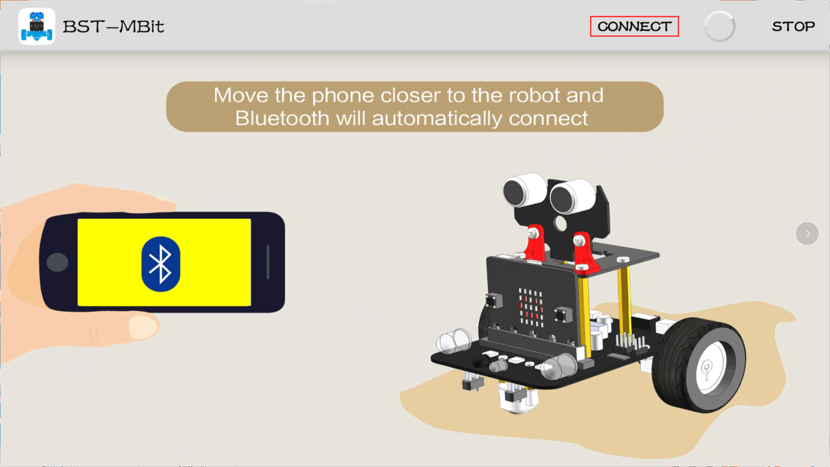
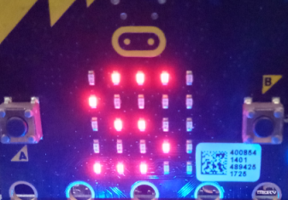
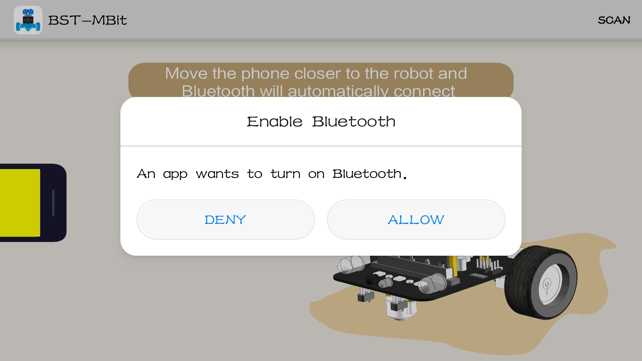
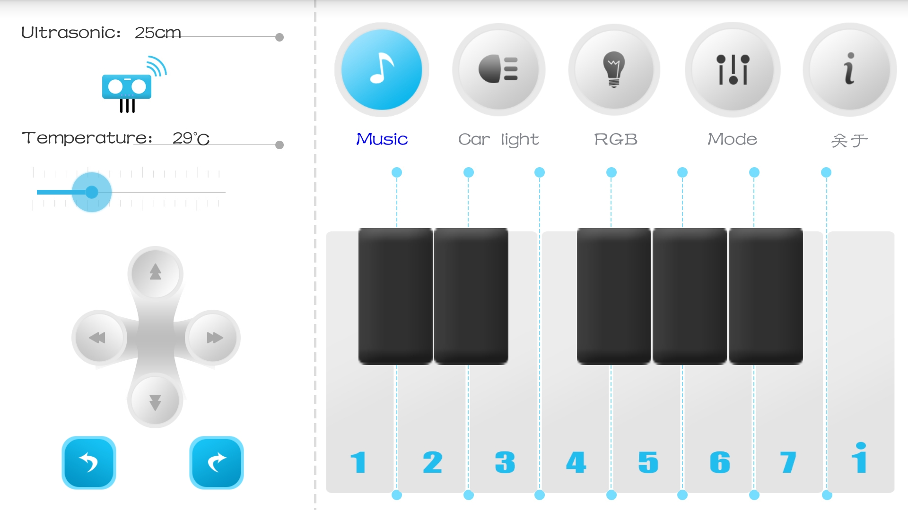
micro:bit robot entry tutorial
Part 1
In this lesson we will learn to use a Bluetooth app to remotely control robots,First of all, we download the program to micro:bit. We can see that the robot's dot matrix shows an "S" as shown in Figure 1.1, this is a state where Bluetooth is not connected. Then turn on Bluetooth, open the Bluetooth remote control APP as shown in Figure 1.2 close to the robot to automatically connect,Alternatively, you can click CONNECT as shown in Figure 1.3 to enter the main control interface, as shown in Figure 1.4.
Learning goals
Figure 1.1
Figure 1.3
YahBoom micro:bit video tutorial
Figure 1.2
Figure 1.4

Slide 5
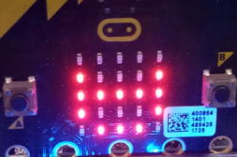
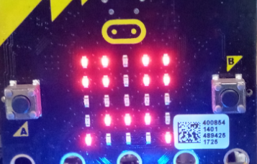
micro:bit robot entry tutorial
Part 1
When the app interface is switched to the screen shown in Figure 1.5, and the robot's dot matrix is ​​switched to the pattern shown in Figure 1.6, the connection is successful and the next operation can be performed. If Bluetooth is disconnected, micro:bit will display the pattern of Figure 1.7.
Learning goals
Figure 1.6
Figure 1.5
Figure 1.7
YahBoom micro:bit video tutorial

Slide 6
micro:bit robot entry tutorial
Part 2
Hardware:
● 1 X micro:bit robot
● 1 X USB cable
● 1 X Infrared controller
● 1 X An Android phone with APP
Preparation
Then the micro:bit is connected to the computer through USB, and the computer will pop up a U disk and click the URL in the U disk to enter the programming interface. Input this URL https://github.com/lzty634158/yahboom_mbit_en to get the package.
YahBoom micro:bit video tutorial

Slide 7
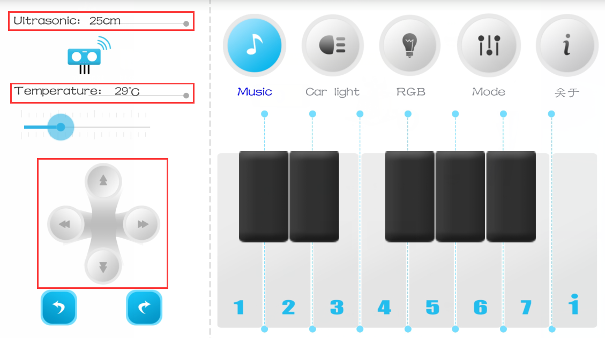
micro:bit robot entry tutorial
Part 3
1.Basic function
Usage method
YahBoom micro:bit video tutorial

Slide 8
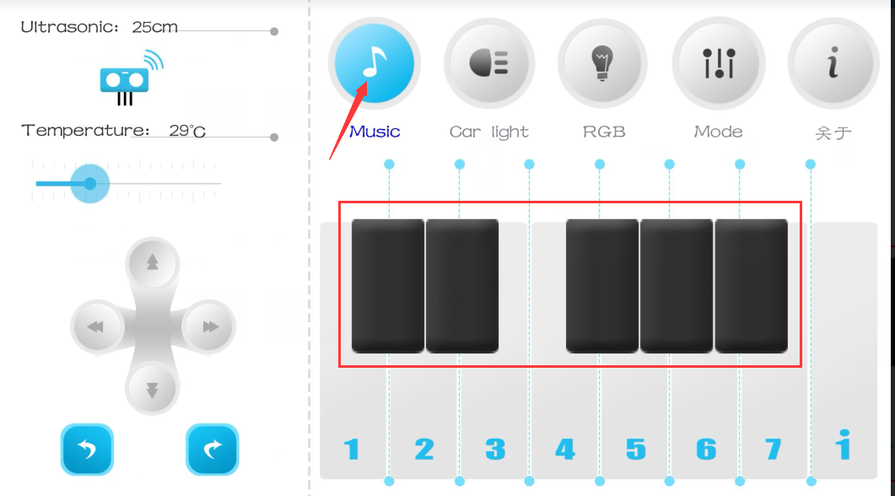
micro:bit robot entry tutorial
Part 3
2.Music
Usage method
YahBoom micro:bit video tutorial

Slide 9
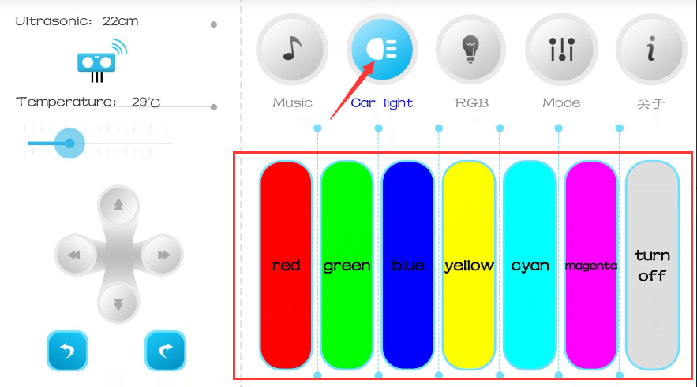
micro:bit robot entry tutorial
Part 3
2.Car light
Usage method
YahBoom micro:bit video tutorial

Slide 10
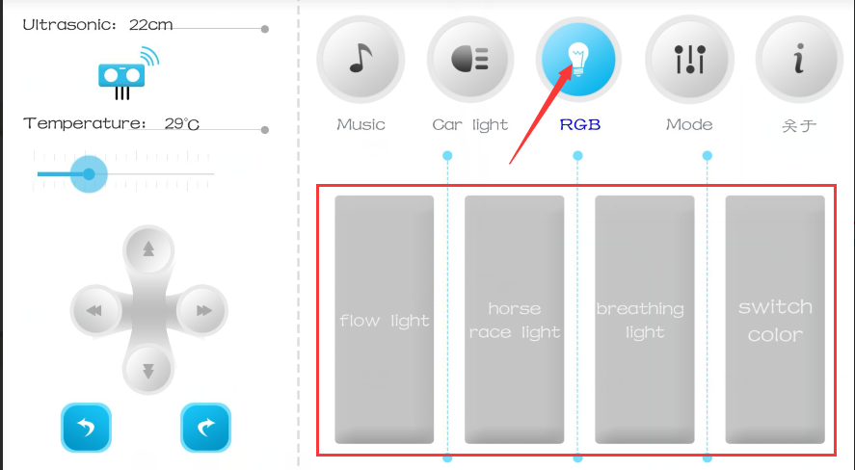
micro:bit robot entry tutorial
Part 3
3.RGB
Usage method
YahBoom micro:bit video tutorial

Slide 11
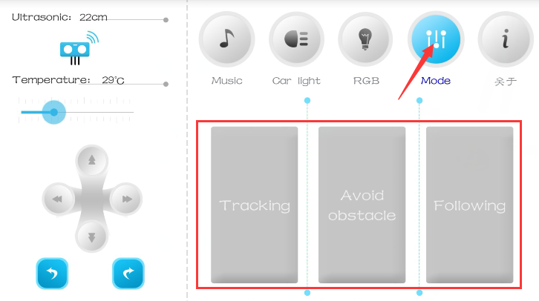
micro:bit robot entry tutorial
Part 3
3.Mode
Usage method
YahBoom micro:bit video tutorial

Slide 12
micro:bit robot entry tutorial
robot
lesson
Thanks for watching！
Powered by YahBoom
YahBoom micro:bit video tutorial

